Slide 1

Strathdearn Community Developments
AGM 9 February 2026

Slide 2
Welcome & Introductions

Slide 3
Quorate?

Slide 4
Previous Minutes – Approval
Approval of Minutes AGM 4th February 2025.

Slide 5
Overview & Metrics

Slide 6
What actually is Strathdearn
Community Developments (SCD)?
SCD is both a charity and a company (limited by guarantee).
Directors are governed both by the Companies Act 2006 and Scottish charities legislation (OSCR), and are able to act within the powers conferred upon them by SCD's Articles of Association.
As with all companies, certain matters are for the Directors to determine, certain matters are for Members to determine at an AGM or EGM, and certain matters can be taken forward by executive employees.
White River Trading (WRT) acts as a trading arm of SCD.

Slide 7
The 'Purposes' of SCD?
The Articles of Association provide the following Purposes for SCD:
  To benefit the community of Strathdearn following the principles of sustainable development.
  The primary Purpose is to further the achievement of sustainable development.

Slide 8
The 'Purposes' of SCD? (cont’d)
  The 5 specific stated Purposes are:
  To provide recreational facilities and activities (to improve quality of life);
  To advance community development (including urban and rural regeneration);
  To advance the education of the community;
  To advance environmental protection or improvement; and
  Relief of those in need.

Slide 9
Employees (SCD)
General Manager, 40 hours per week (new post since last AGM)
Project and Community Development Manager, 40 hours per week
(post is end dated late-Apr / early-May 26)
Project Assistant, 20 hours per week
Events Co-Ordinator, 10.5 hours per week
Minute Secretary and Administrator, 7 hours per week
Company Secretary, 10 hours per week
Woodlands Co-Ordinator, 15 hours per week (new post since last AGM)
Current total SCD Staffing = 3.6 FTE (assuming 40hrs per week as standard)
Total SCD Staffing forecast from May 26 = 2.6 FTE

Slide 10
Employees (WRT)
The Strathdearn Ops Team, 72 hours per week
Tastes of Tomatin Ops Team, 110 hours per week
Finance Administrator, 22 hours per week (split evenly The Strathdearn and Tastes of Tomatin)
Additional operations Bank Staff, Zero Hour/Floating
[Additional hours can arise depending on operational need (on a case-by-case basis)]
Total WRT Staffing = 5.1 FTE (assuming 40 hours per week standard)

Slide 11
Size of Workforce vs. Driving Factors
The following factors influence the size and shape of the SCD/WRT teams:
  The charity now equates to a medium size business enterprise (e.g. Total Income £1.7M, Asset Value increased significantly in recent years to £4.1 (rising to circa £5.0M when houses are complete)).
  Volume and complexity of work has increased (e.g. houses and woodland).
  There was a pressing need to reduce time and pressures on volunteer Directors (and help lift them out of the day-to-day drumbeat of operational activity (i.e. instead be more strategic in their outlook)).
  Justified against income received from wind farms, various grants, etc.

Slide 12
Significant Achievements
All 5 Resolutions at last year’s AGM complete (no Resolutions this year).
Affordable Housing nearing completion.
Purchase of Hazelbank Woods complete.
The Strathdearn (‘Hall’) turnover improving.
Faster EV Chargers installed.
Solar Panels continue to reduce energy costs.

Slide 13
Significant Challenges &
Opportunities
Tastes of Tomatin.
New wind farms.

Slide 14
Debt 2018 - 2025
Debt used for first time mid-2019 to finance hub, shop & café.
Early repayment of £250,000 made mid-2021.
Current loan on hall due to be repaid 2032.
Borrowing of ~ £240k on housing to be drawn 2026 per previous year’s Resolution.

Slide 15
Total Funds 2018 - 2025
SCD reached its 12th anniversary on 30 October 2025, 11 years since receiving its first income.
Total Funds to March 2025 was £4.17m, 6-fold increase from 2018.
Value mostly (70%+) comprised of hard assets – hall, shop, café, woodland, machinery, equipment.
Healthy cash position built ahead of housing build that commenced in Spring 2025.

Slide 16
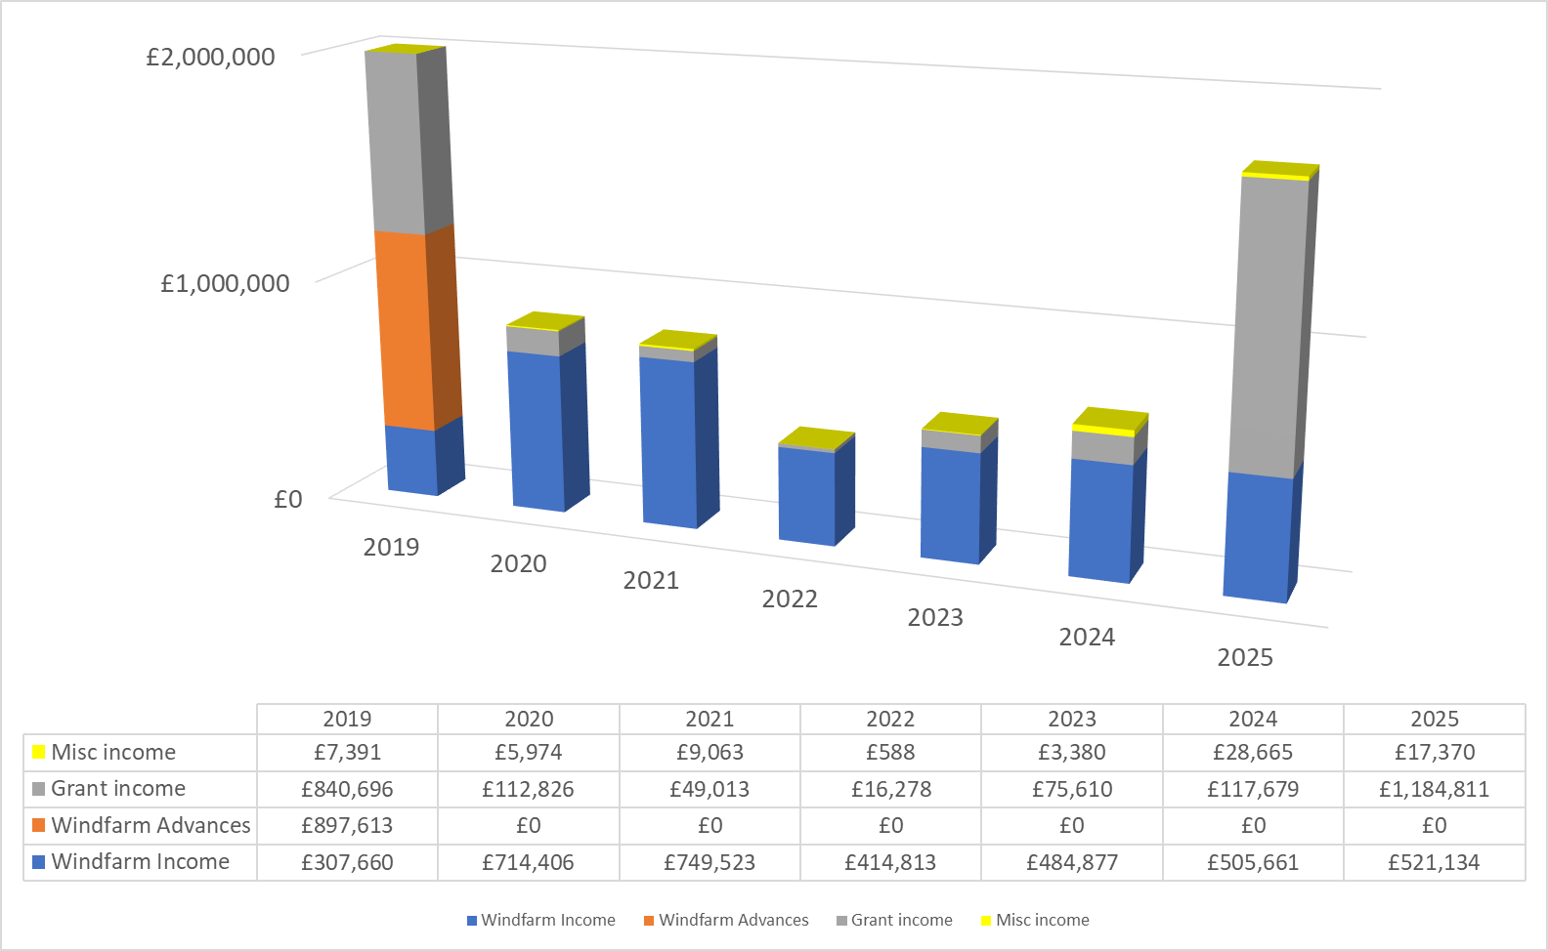
Income 2019 - 2025
SCD total income to Mar’25 was £1.723m in the year, excluding £269k WRT trading income.
Grant awards £1.184m (including £832k for housing & £299k Hazelbank Wood purchase).
Annual wind farm benefit of £521k received from three operators (Dunmaglass, Moy, Glen Kyllachy).
Misc income £17k.

Slide 17
Grant Income vs. Staff cost 2018-2025
Total grant income from 2018 to 2025 (excluding SCCT) was £2.066m (e.g. £832k (housing); £500k (hall) £299k (woodland); £156k (staffing grant); £90k (PV panels).
SCD staff cost (exc WRT) for same period £649k.
Large cost/benefit returns for community

Slide 18
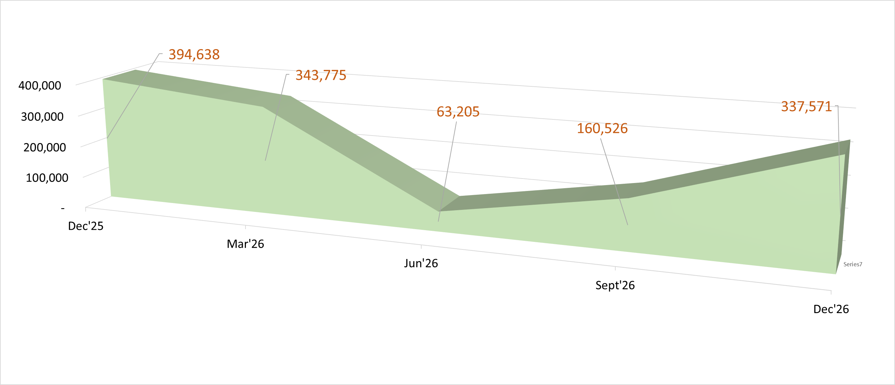
Cash forecast for next 12 months

Slide 19
PRESENTATION OF SCD GROUP ACCOUNTS to 31 March 2025

Slide 20
STATEMENT OF FINANCIAL ACTIVITIES

Slide 21
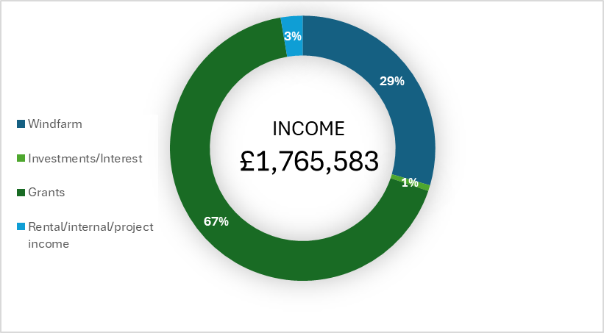
SCD (Charity)

Slide 22
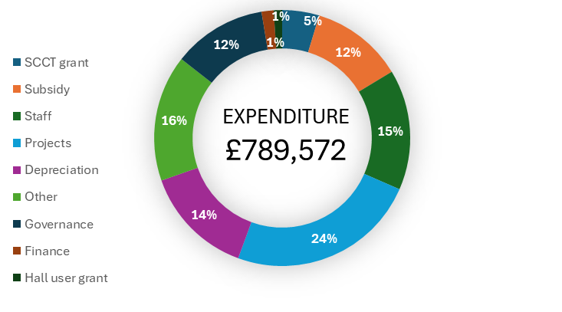
SCD (Charity) Net Income = £976,011

Slide 23
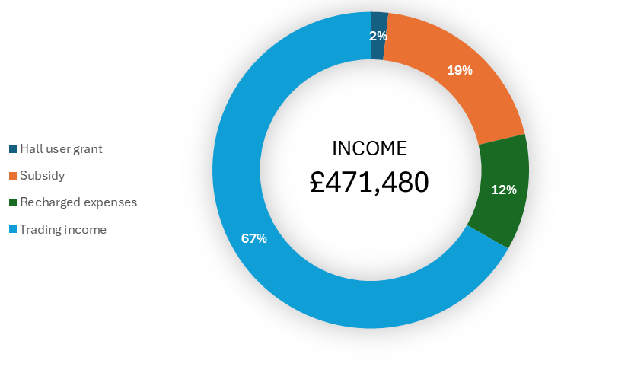
White River Trading

Slide 24
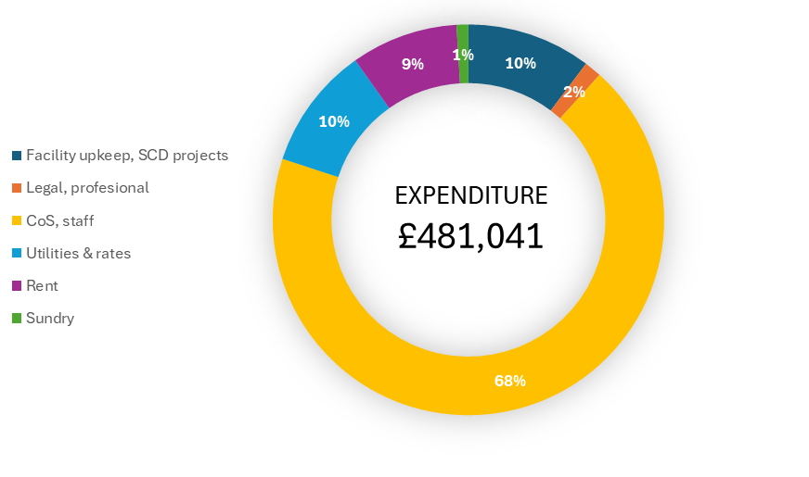
WRT Net Income = (£9,559)

Slide 25
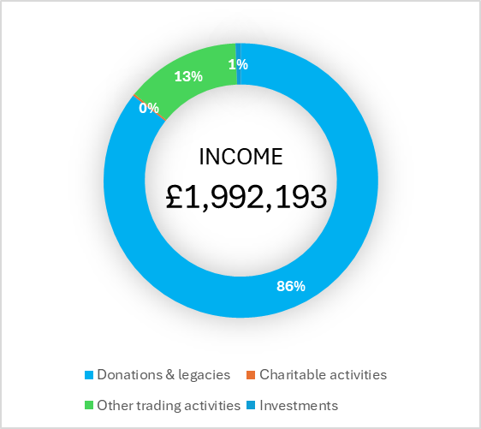
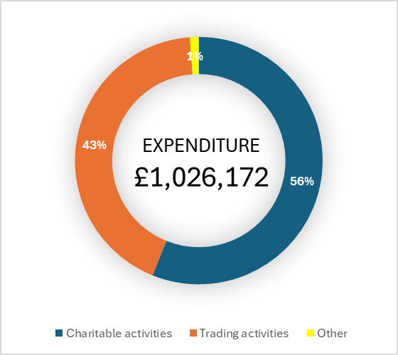
SCD Group Net Income = £966,021

Slide 26
BALANCE SHEET

Slide 27
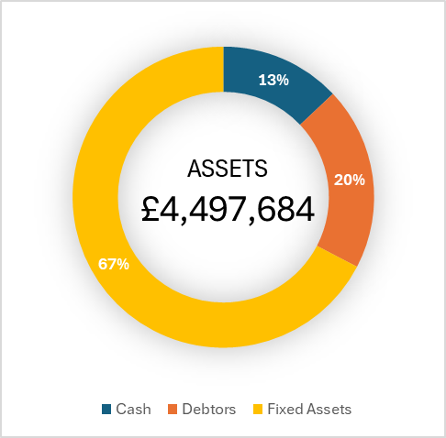
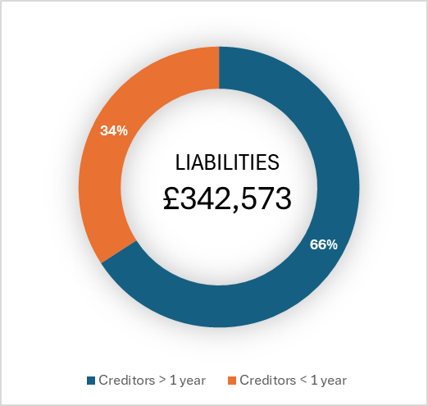
SCD (Charity) Net Assets = £4,155,111

Slide 28
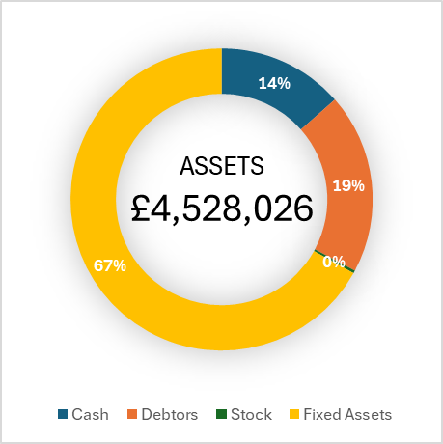
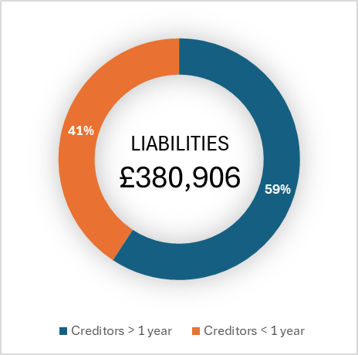
SCD Group Net Assets = £4,147,120

Slide 29
AUDITOR REPORT
Summary:
The financial statements:
  Give a true and fair view.
  Have been properly prepared to requirements.
Have not identified anything that casts significant doubt on the Group’s ability to continue for a period of at least twelve months. I.e. SCD is a Going Concern
The Trustees’ Report is consistent with the financial statements and no material misstatements have been identified.

Slide 30
QUESTIONS?

Slide 31
APPROVAL OF ACCOUNTS

Slide 32
APPOINTMENT OF AUDITORS / EXAMINERS

Slide 33
STRATEGIC LOOK AHEAD
Board's main focus moving forward is 'Sustainability'.
Move from significant, relatively expansive Asset building (via notably large projects), to a period of consolidation.
Local Place Plan / Community Action Plan (LPP / CAP).
SCD/WRT Six Month Business Delivery Plan.
Will use the outcomes and views from this AGM to shape and influence the Charity’s future strategy.

Slide 34
Composition of the Boards
  Must have a minimum of 3 Directors, and a maximum of 10.
  6 elected Directors (must be Ordinary Members) - vote only required if more than 6 apply.
  1 Strathdearn Community Council (SCC) appointed Director.
  1 Strathdearn Community Charitable Trust (SCCT) appointed Director.
  2 co-opted Directors (do not need to be Ordinary Members).
  Appoints WRT Board at first meeting after the AGM.
Strathdearn Community Developments (SCD) Board:

Slide 35
Composition of the Boards
2026 SCD Board:
  Graeme Ferguson (elected – current Chair)
  George Macleod (elected)
  Gordon Noble (elected at 2026 AGM – previously co-opted)
  Frank Roden​​ (SCCT appointed Director Representative)
  Kevin McKnight (SCC appointed Director Representative February 2026 onwards)
  Duncan Bryden – (elected current Vice Chair – stepping down after AGM)

Slide 36
Composition of the Boards
2026 WRT Board:
  Steven Knott – Chair.
  Graeme Ferguson – Director (SCD Representative).

Slide 37
Composition of the Boards
Barbara MacAskill.
Liz Campbell – has an interest in rejoining WRT Board
Sandra Edward.
Angus MacLeod.
Jimmy Duncan.

Slide 38

Closing
Questions Arising?
Any Other Business?

